Slide 1
CHAPTER 7.3:
Intercepts and Standard Form
Algebra concepts

Slide 2
Objective
Students will graph linear equations using intercepts.
Students will graph linear equations that graph as horizontal and vertical lines.

Slide 3

$$Intercepts$$
The x-Intercept of a line is the x-coordinate of the point where the line intercepts the x-axis
The y-intercept of a line is the y-coordinate of the point where the line intercepts the y-axis.

Slide 4

$$Finding Intercepts$$
To find the x-intercept let the y=0 and solve for x.
To find the y-intercept let the x=0 and solve for y.

Slide 5
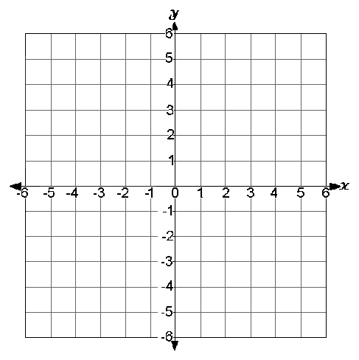
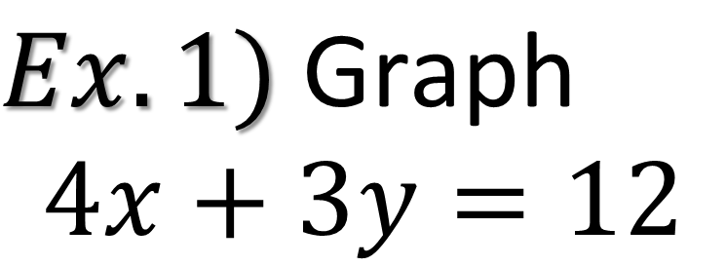
$$Ex.1) \text{Graph}$$
$$4x+3y=12$$

Slide 6
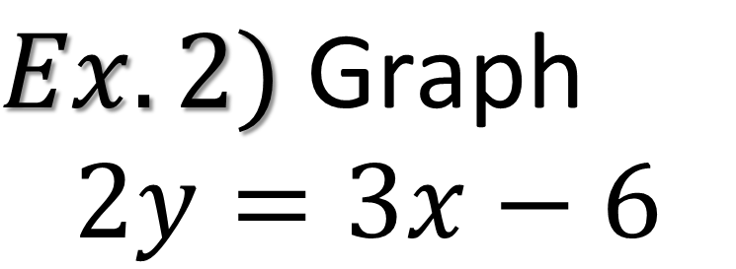
$$Ex.2) \text{Graph}$$
$$2y=3x−6$$

Slide 7
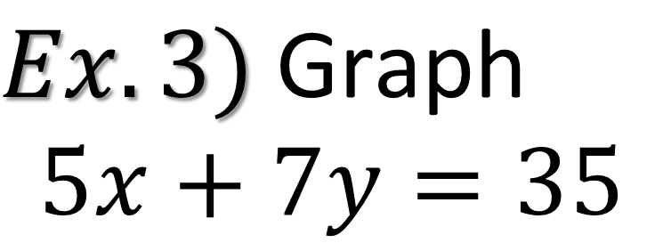
$$Ex.3) \text{Graph}$$
$$5x+7y=35$$

Slide 8
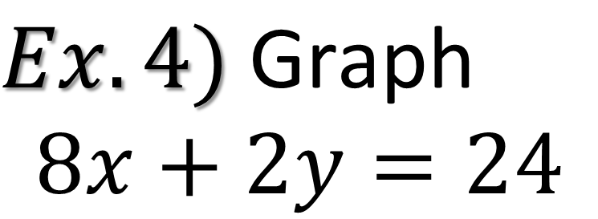
$$Ex.4) \text{Graph}$$
$$8x+2y=24$$

Slide 9
Horizontal and Vertical Lines
When you only have one variable the graph is going to be either a horizontal or vertical line.
  If you have “y = ” the graph will be a line parallel
  with the x-axis
  If you have “x = ” the graph will be a line parallel
  with the y-axis

Slide 10
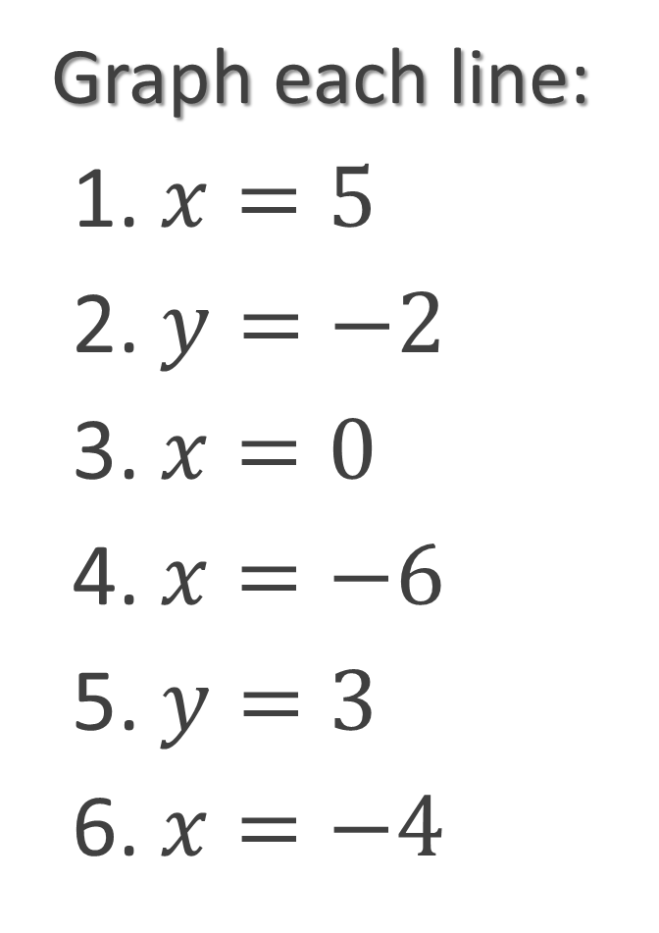
Graph each line:
1. $x=5$
2. $y=−2$
3. $x=0$
4. $x=−6$
5. $y=3$
6. $x=−4$

